Slide 1


Streaming Services
Summer Kenney
Caitlin McDaniel
Jaclyn Huff

Slide 2

About the Team- Summer Kenney
Life-long learner
Excellent Soft Skills
Background starting and managing small businesses
Curated and ran successful marketing campaigns for several companies.
Enthusiastic and excited about data and the way it can impact the world.
Scientist at heart

Slide 3
NETFLIX
I can still remember the excitement of running to our mailbox to see if our latest Netflix DVD had come in the mail!
Fast forward two decades and Netflix has become one of the biggest TV and movie studios in the world, with more subscribers than all the cable TV channels in America combined.

Slide 4
Netflix Key Statistics
Netflix generated $24.9 billion revenue in 2021, a 23.8% increase year-on-year
$12.97 billion of Netflix’s revenue was generated in North America, its largest market
Netflix had an operating profit of $5.1 billion in 2021, an 85% increase year-on-year
In 2022, Netflix had 222 million subscribers worldwide

Slide 5
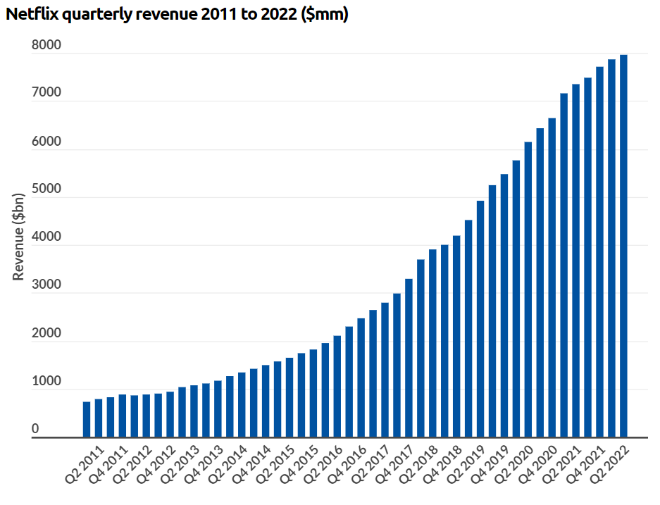
Netflix Revenue
Netflix generated $24.9 billion revenue in 2020, a 23.8% increase on the previous year. It has reported higher revenues each quarter for more than a decade.

Slide 6
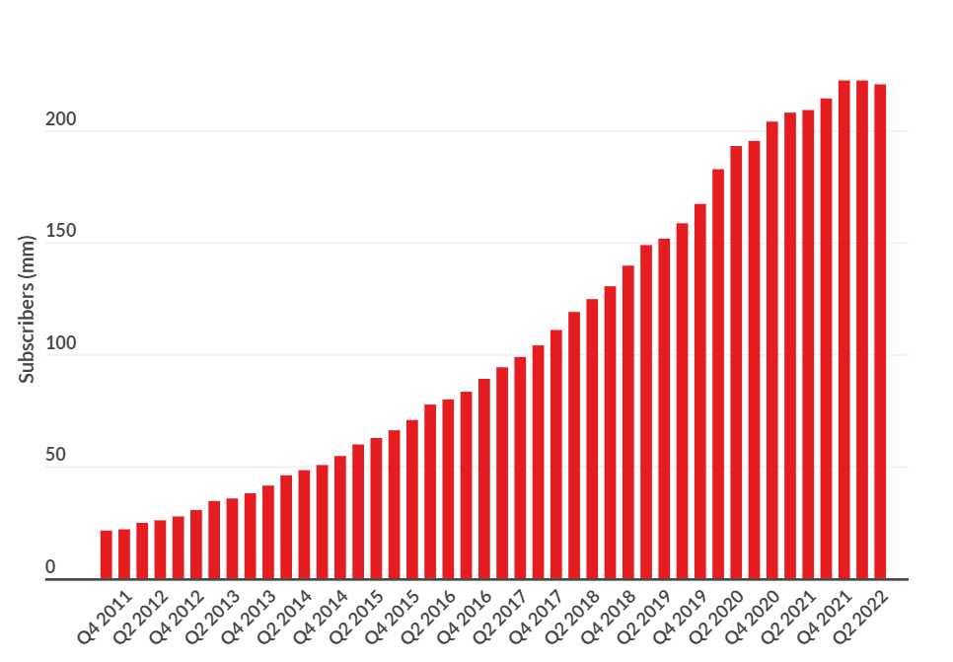
Netflix Subscribers
Netflix reached 222 million subscribers in 2021, but stalled in Q1 2022, losing 200,000 subscribers and wiping over 50% off its market cap.

Slide 7

Netflix FAQ’s
What is the most streamed TV show on Netflix?
The Office is the most streamed piece of content on Netflix, with a total of 57.1 billion minutes
What is the median age of a Netflix user?
The median age is between 35-44 years old
How many Netflix users use the platform without paying?
An estimated 31% of users do not pay for the platform
How many unique recommendations does Netflix have?
Netflix has 1,300 “recommendation clusters”, which are built through user’s viewing preferences
How many hours of Netflix were streaming during coronavirus lockdown?
In the US, an estimated 204 million hours were collectively streamed during the first major coronavirus lockdown in 2020

Slide 8
Data Set Examined This dataset, taken from Kaggle.com contains +5k unique titles on Netflix with 15 columns containing their information, including:
id: The title ID on JustWatch.
title: The name of the title.
show_type: TV show or movie.
description: A brief description.
release_year: The release year.
age_certification: The age certification.
runtime: The length of the episode (SHOW) or movie.
genres: A list of genres.
production_countries: A list of countries that produced the title.
seasons: Number of seasons if it's a SHOW.
imdb_id: The title ID on IMDB.
imdb_score: Score on IMDB.
imdb_votes: Votes on IMDB.
tmdb_popularity: Popularity on TMDB.
tmdb_score: Score on TMDB.

Slide 9
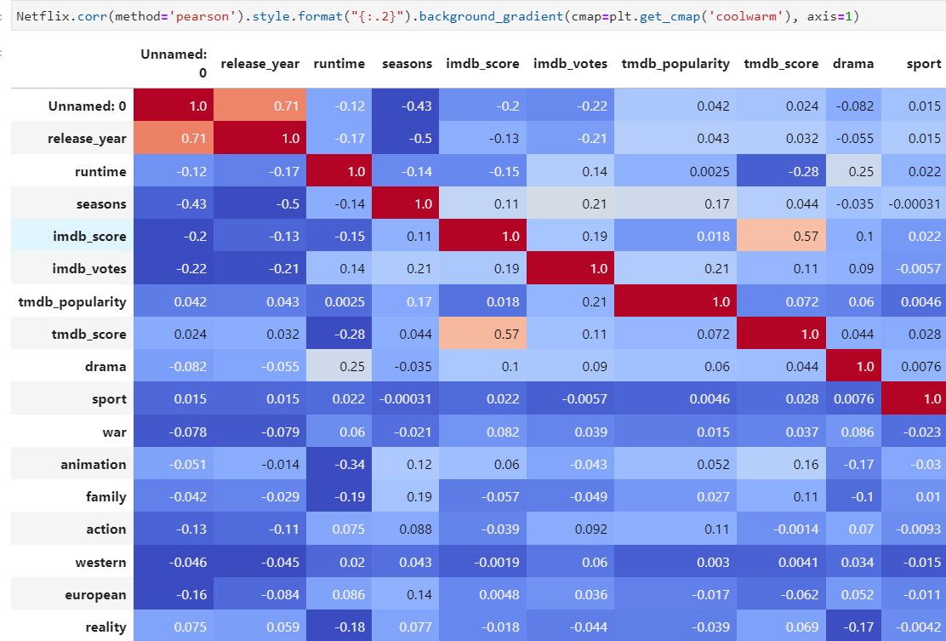
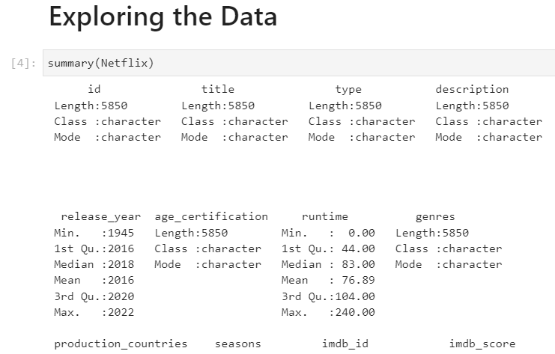
Data Set Exploration
The team uploaded the data set into an R notebook. They wanted to find out how many rows (5,850), and columns (15). They also examined the column types (char, int, etc.).
Next, the team opened a Python notebook and continued to explore the data, looking at how many null values were present, the data types, etc. They created a correlation matrix to be able to have a cursory perusal of any correlations between factors.

Slide 10



Continuing the Exploration
The first thing that piqued their interest was regarding whether a show’s rating had a correlation to its popularity score (IMDB in this case) so the team asked this question:
Is there a difference in IMDB scores among the age certifications of TV-MA(mature audience), TV-Y(child audience), and TV-G(general audience)?

Slide 11
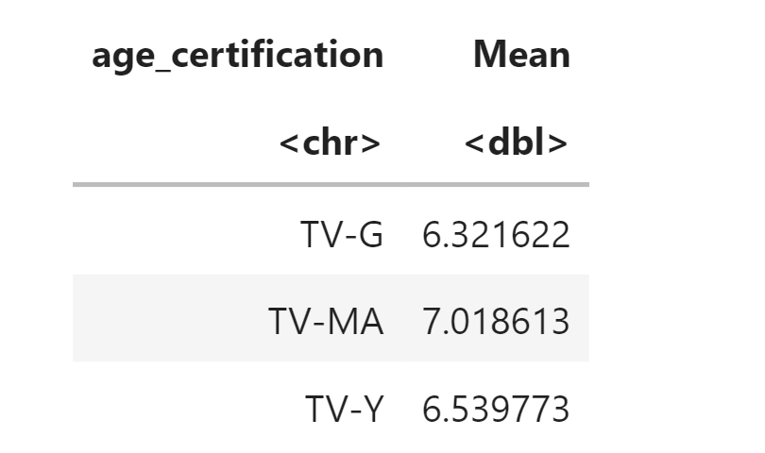
Answering the Question
The team pulled out only shows from the data set that had the selected ratings and chose to run a 1 way, between-subject ANOVA (analysis of variance) on the three ratings. They tested for all necessary assumptions and upon computing post hoc found that there was a significant difference in score between G rating and MA rating and between Y and MA rating. There was not a significant difference between G and Y ratings.
They examined the means so that I could draw some conclusions. What they found was that television with a rating of ‘MA’ had significantly higher IMDB scores than television that was made for children and a general audience (Y and G)!

Slide 12
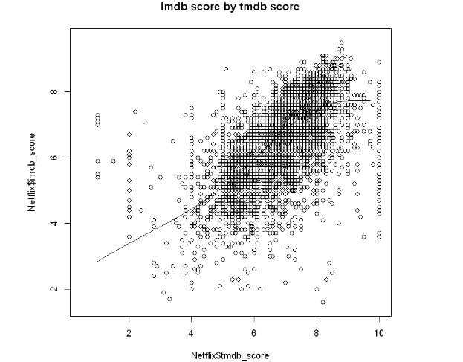
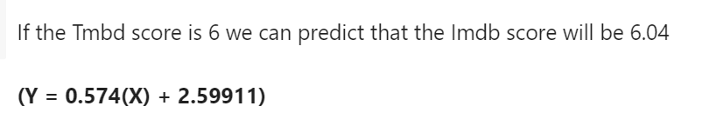
Creating a Linear Model
The team wanted to look closer at the popularity ratings themselves and for this data set, we had two: IMDB and TMDB.
The team wanted to answer the question: How are the TMDB and IMDB scores related?
They created a test for linearity that passed, which means that there is a linear relationship between the two ratings. Once all the assumptions were met, they were able to create a prediction model that could predict a show or movie's IMDB score based on a given TMDB score.

Slide 13

Those proved to be interesting insights into the data, but as the team began to work together, they decided to put an emphasis on how shows and movies have changed through the decades.

Slide 14
The team decided to run a stepwise regression to see what the strongest correlating factors were given for ‘release year’. The strongest correlations shown were:
1. runtime
2. age_certification
3. imdb/tmbd_scores
4. number of seasons.

Slide 15
After considering the exploratory tests they decided to examine the following three questions:
Have movie and show times changed through the decades? If so, how?
Have IMDB ratings changed for movies and shows over the decades? If, so how? And,
How do IMDB scores compare among the various streaming services of Hulu, Netflix, and HBO?

Slide 16



The first thing that the team did was break up the release year into 3 separate decades: 1990-1999, 2000-2009, and 2010-2019 – 90’s, 00’s 10’s

Slide 17
QUESTION1: How have running times changed through the decades?
In order to answer the first question, they needed to first explore the means of each and see how they compared to one another. The test for variance for both shows and movies came back with the result that there IS a significant difference between run times over the decades!
So, they went back to look at the averages and found the following…

Slide 18
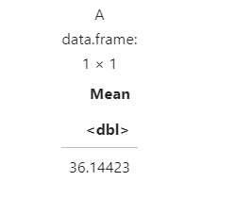
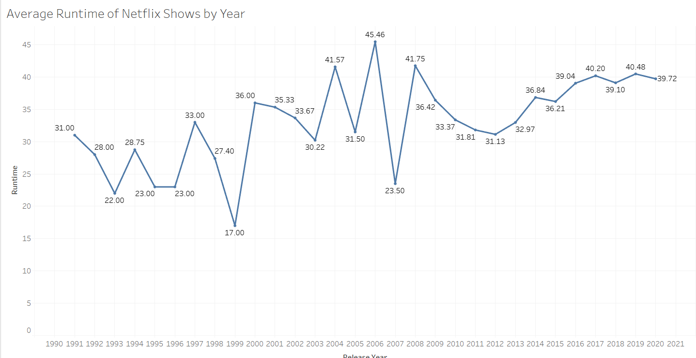
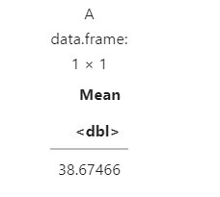
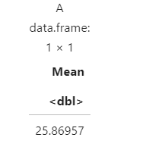
Runtimes for Netflix shows were considerably shorter in the 1990’s but remained fairly constant for the last two decades.
2020’s average runtime for shows
2010’s average runtime for shows
1990’s average runtime for shows

Slide 19
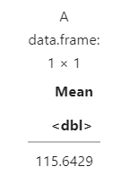
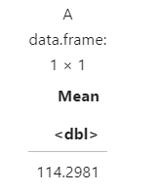
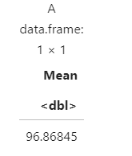
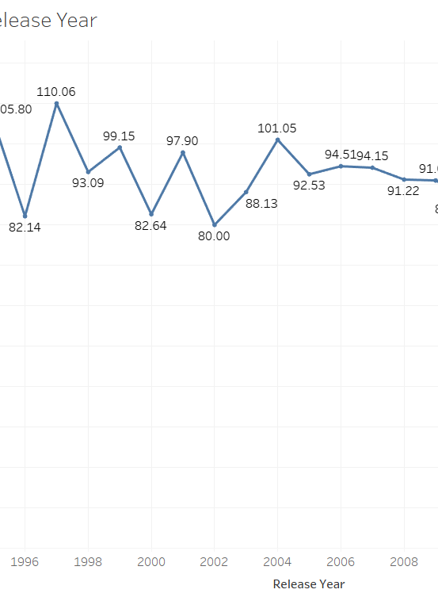
Movie times were considerably longer in the 90’s and 00’s than in the last decade. Movie times have decreased significantly since 2010.
1990’s average movie time
2000’s average movie time
2010’s average movie time
All decade's average movie time

Slide 20
QUESTION 2: Have IMDB ratings changed for movies and shows over the decades? If, so how?
Running the same tests on IMDB scores as they did on runtimes over the decades showed that there is some statistically significant variance to be explored!

Slide 21
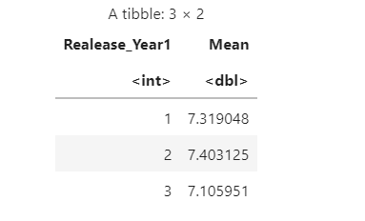
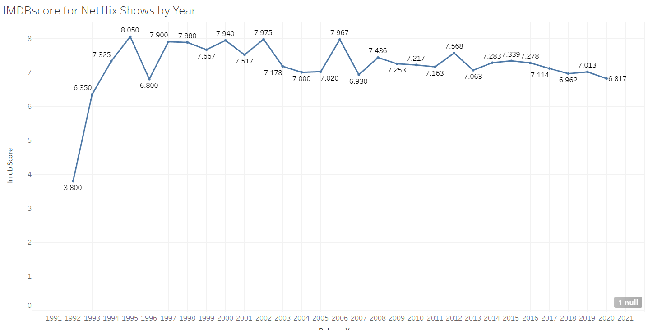
How have IMDB scores changed for shows over the decades?
1 = 1990-1999
2 = 2000-2009
3 = 2009-2019
We can see that while the ratings for shows have not varied drastically, the most recent decade shows a slight decline in average rating.

Slide 22
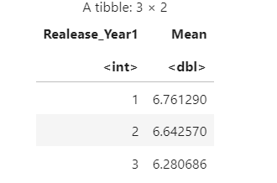
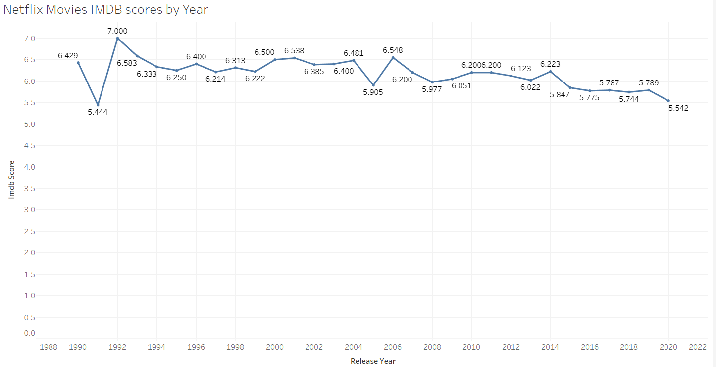
How have IMDB scores changed for movies over the decades?
1 = 1990-1999
2 = 2000-2009
3 = 2009-2019
Once again, we can note a decline in average ratings in the most recent decade. Interesting to note is how the movie IMDB ratings are significantly lower than the show IMDB ratings.

Slide 23
Combining the Data Sets
Now that the team had some interesting insights into the Netflix data set, they wanted to see how it compared to some of the other major streaming services.
They combined the Netflix data set with a Hulu and HBO data set to make one big streaming services data set.
They took some time to explore this new combined data set in both python and R.
Once they found the mean IMDB scores for the combined data set for both movies and shows, it was time to compare!

Slide 24
How does Netflix measure up?
The team ran a T-test to see if the average IMDB scores for Netflix were the same as the average IMDB scores for the combined data set.
First up was movies. The test showed that there IS a significant difference between the overall average IMDB score and the Netflix IMDB score for movies.
Next the test for shows revealed that there was NOT a statistically significant difference between the Netflix average and the overall average.

Slide 25
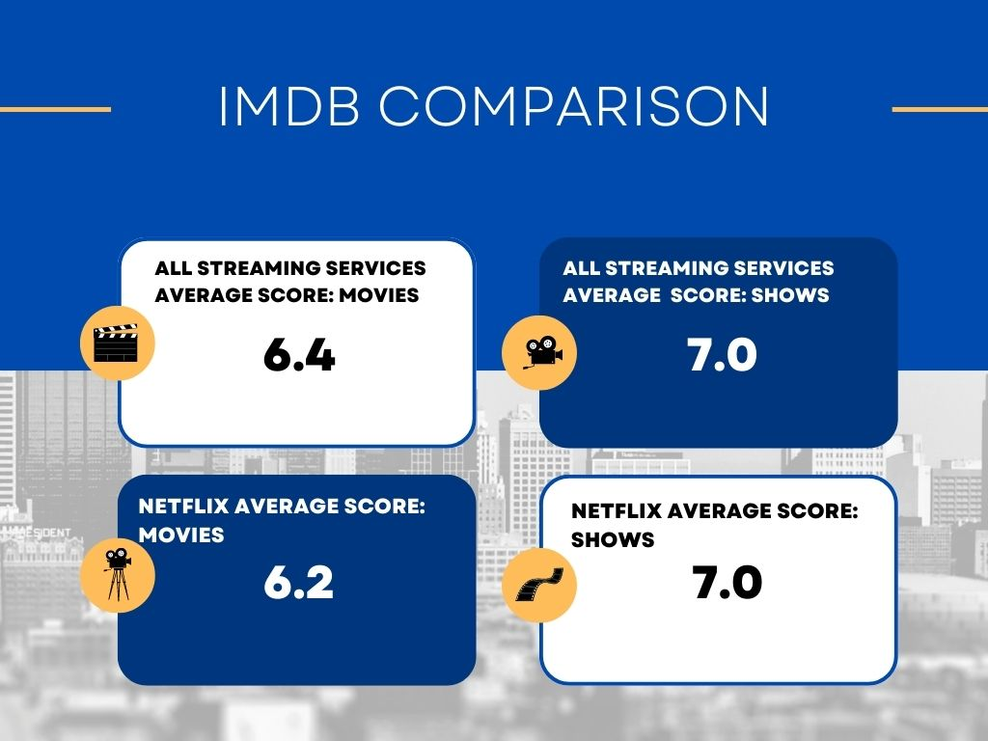
Netflix movies scored lower than the overall average
Netflix shows scored the same as the overall average.

Slide 26
Netflix Summary
Netflix content intended for more mature audiences garner higher popularity ratings than Netflix’s content for a younger or family audience.
Netflix television shows were significantly longer in the 1990’s than in recent decades.
Netflix movie times have decreased significantly since 2010.
Television shows have shown a decrease in IMDB ratings in the last decade.
Movie IMDB ratings have decreased in the last decade.
The average IMDB rating for shows is on par with the competition but the IMDB ratings for movies is significantly lower than the competition.

Slide 27
HBO Max
HBO Max was launched in the United States on May 27, 2020. However, I am pretty sure most people have memory of seeing HBO movies from years before then.
According to AT&T, HBO and HBO Max had a combined total of 69.4 million paying subscribers globally on June 30, 2021, including 43.5 million HBO Max subscribers in the U.S., 3.5 million HBO-only U.S. subscribers (primarily commercial customers like hotels), and 20.5 million subscribers to either HBO Max or HBO by itself in other countries. By the end of 2021, HBO and HBO Max had a combined total of 73.8 million paying global subscribers. At the end of Q1 2022, HBO and HBO Max had 76.8 million global subscribers.
Pretty impressive

Slide 28
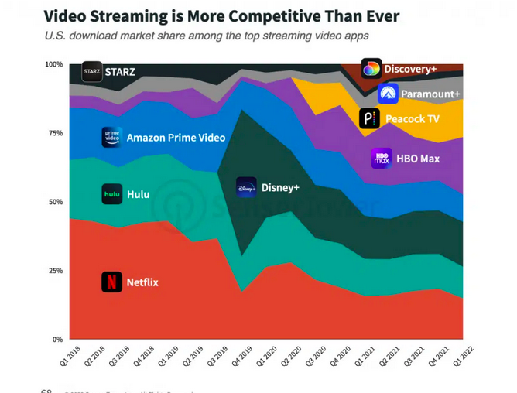
+ HBO Max led in market share of US app downloads with 21% in Q1 2022, followed by Disney+ and Netflix. The video streaming app was also among the top apps with the highest monthly active users with 10% of market share. The platform has had success adding new users since with its U.S. market share climbing from 4.5% in Q2 2020 to 10% in Q1 2022.

Slide 29
Data Set Examined:
/Users/caitlinbailey/Downloads/archive(2)/HBOtitles1.csv
This dataset, taken from Kaggle.com contains +5k unique titles on HBO Max with 15 columns containing their information, including:

Slide 30
Data Set Examined
id: The title ID on JustWatch.
title: The name of the title.
show_type: TV show or movie.
description: A brief description.
release_year: The release year.
age_certification: The age certification.
runtime: The length of the episode (SHOW) or movie.
genres: A list of genres.
production_countries: A list of countries that produced the title.
seasons: Number of seasons if it's a SHOW.
imdb_id: The title ID on IMDB.
imdb_score: Score on IMDB.
imdb_votes: Votes on IMDB.
tmdb_popularity: Popularity on TMDB.
tmdb_score: Score on TMDB.

Slide 31
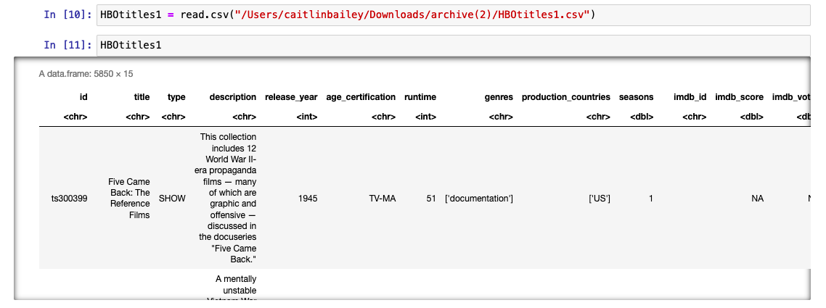
Data Set Exploration
First, I installed and opened binary packages such as dplyr, ggplot, rcompanion, and many more.
Then I uploaded the dataset in Jupyter Notebook (r)
I also viewed the dataset which showed a data frame of 5850 x 15

Slide 32
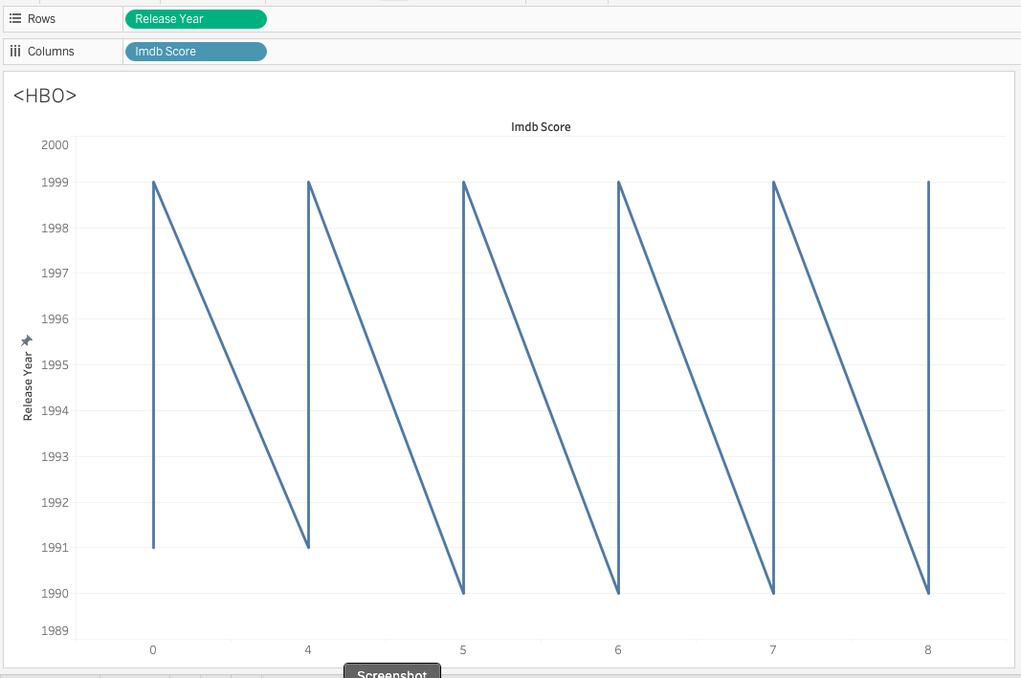
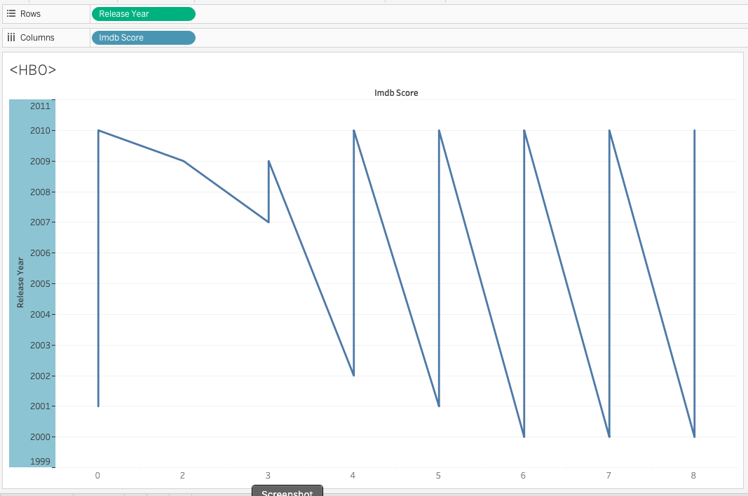
Have average IMDB scores changed for shows and movies over the decades?

Slide 33
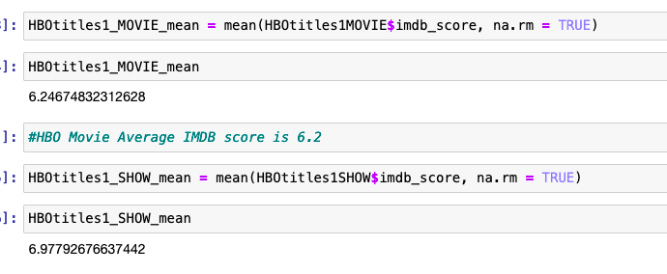
Tableau was considerably funny to work with. In terms, we wanted to know the average IMDB scores for movies and shows over the decades. After a bit of coding, 6.24 is the average IMDB score for all HBO Max Movies in the years of 1990-2020
6.97 is the average IMDB score for all HBO Max Shows

Slide 34
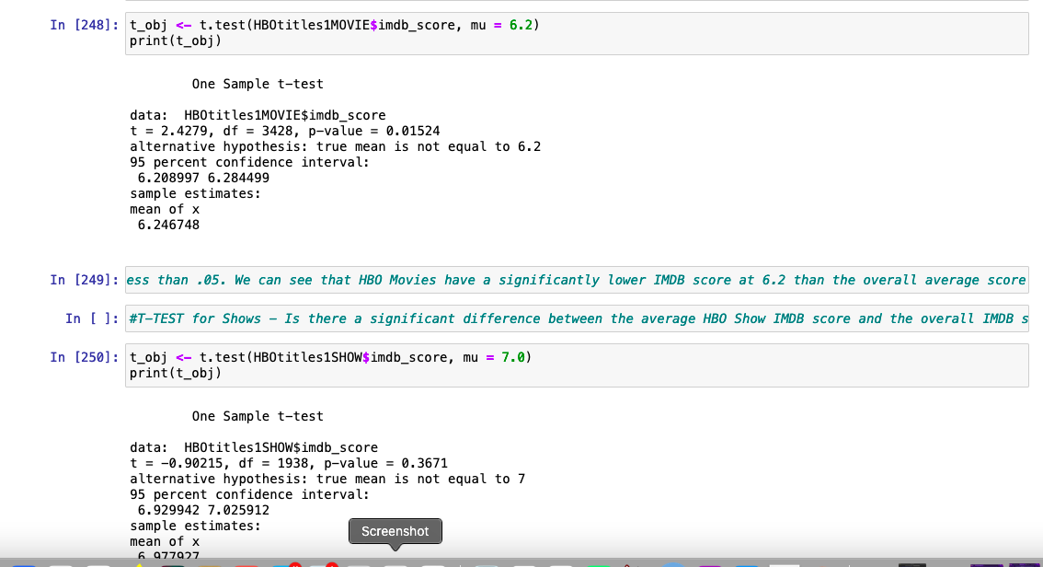
Perform a T-test using the combined data set's averages as mu and your data set's average as the sample mean.

Slide 35
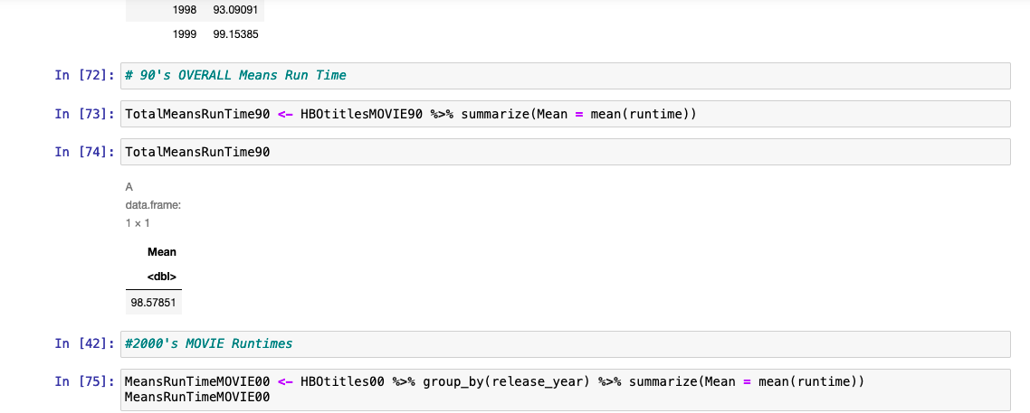
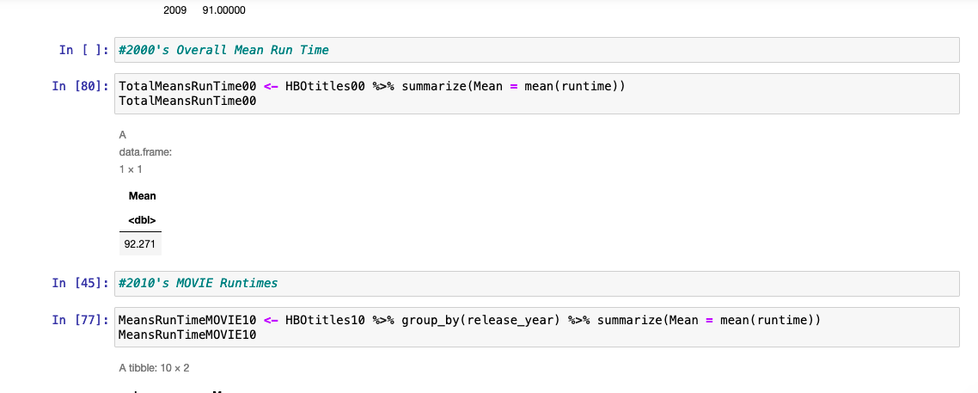
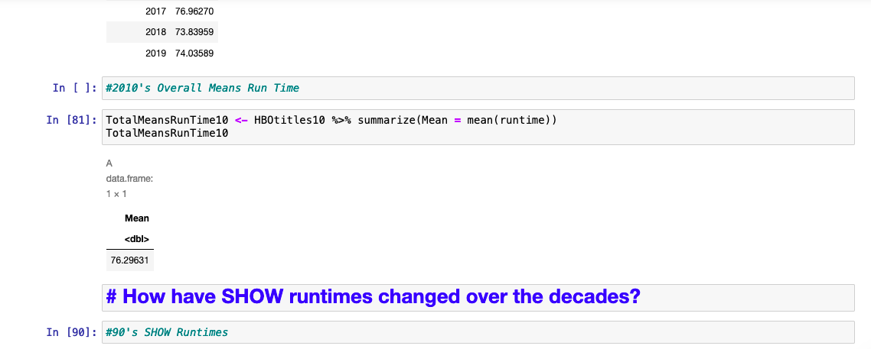
How have movie times changed throughout the decades?
First things first: I downloaded and installed the packages that I would be using.
The overall MeansRunTime for the 90’s is 96.57
00’s is 92.27
10’s is 76.29
There is a slight difference in the 90’s and 00’s. However MeanRunTime for MOVIE were lower in the 10’s

Slide 36
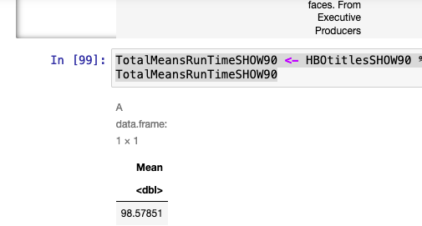
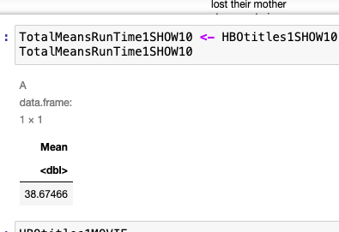
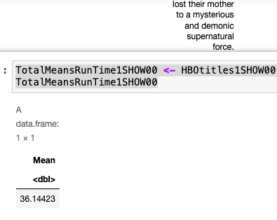
How have show times changed throughout the decades?

Slide 37
Reference page
https://mobilemarketingreads.com/hbo-max-revenue-and-usage-statistics/#:~:text=%2B%20HBO%20Max%20parent%20company%E2%80%99s%20revenue%20reached%20%2441,but%20ahead%20of%20estimates%20for%20%2440.4%20billion.%20%28Deadline%29
https://trello.com/b/dyuczLm8/streaming-services-final-project

Slide 38
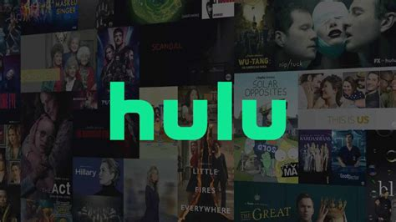

Slide 39
About the Team-Jaclyn Huff
Prior to studying Data Science, I worked in medical research for 18 years as an SRA.
I am certified in Thai Reflexology, and I am Mindfulness Practitioner.
Passionate and keen about how technology is changing the world around us.

Slide 40
Hulu
Hulu is an American subscription streaming service majority-owned by The Walt Disney Company, with Comcast’s NBCUniversal holding a minority stake. It was launched on October 29, 2007, and it offers a library of films and television series from networks like ABC, Freeform, and FX Networks, and among others, as well as Hulu original programming.
Hulu launched a subscription service, initially branded as Hulu Plus, which featured full seasons of programs from the companies and other partners, and undeleyed access to new episodes. In 2017, the company launched Hulu with Live TV—an over-the-top live TV service featuring linear television channels.
As of July 2022, Hulu has a total of 46.2 million subscribers.

Slide 41
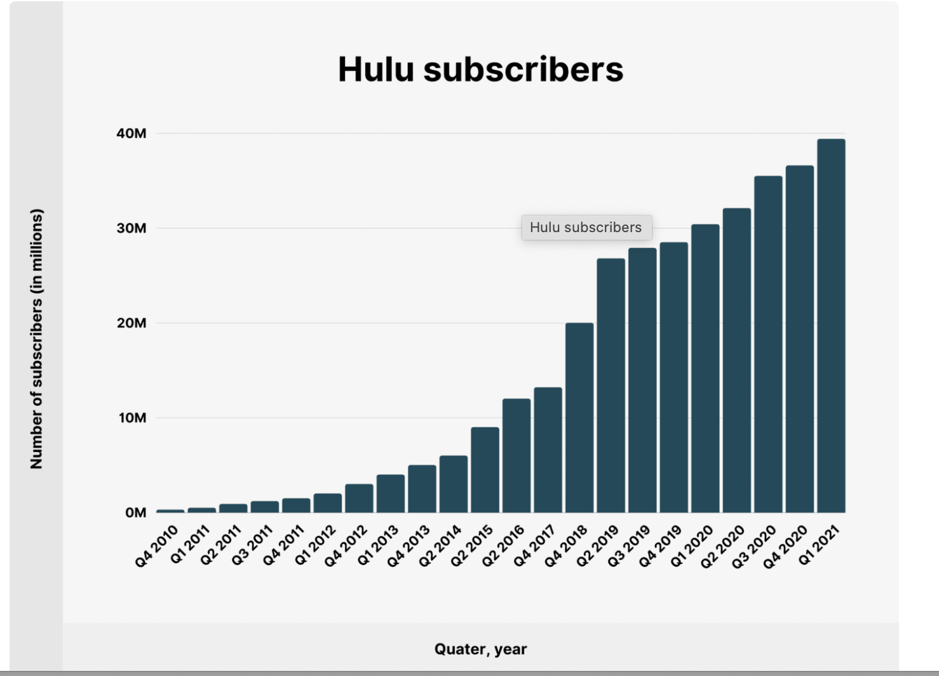
Over the last 8 years, Hulu has grown its paid subscriber base at a CAGR of 33.1%.

Slide 42
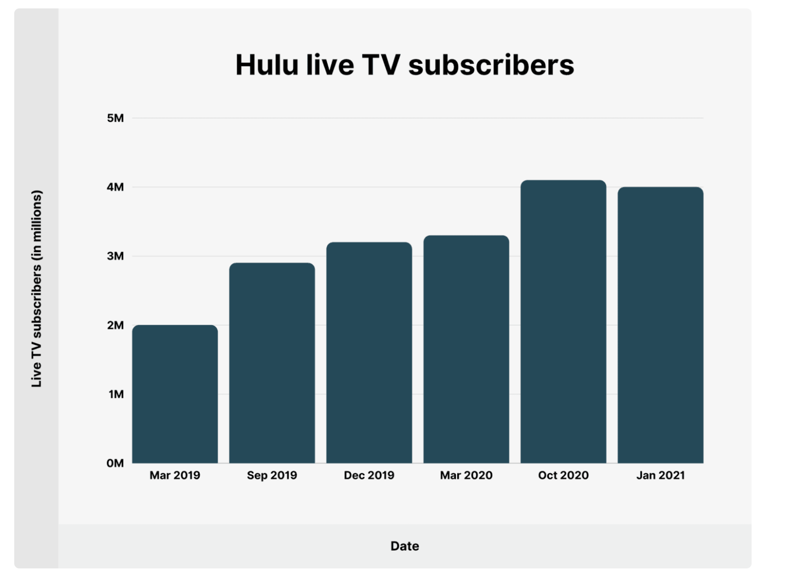
Live TV on Hulu Hulu’s live TV bundle has 4 million subscribers. The package provides access to live programming in addition to the on-demand library. During the last year (December 2019 – January 2021), Hulu added 800 thousand new live TV subscribers.

Slide 43
Data Set Examined This dataset, taken from Kaggle.com contains titles on Hulu with 15 columns containing their information, including:
id: The title ID on JustWatch.
title: The name of the title.
show_type: TV show or movie.
description: A brief description.
release_year: The release year.
age_certification: The age certification.
runtime: The length of the episode (SHOW) or movie.
genres: A list of genres.
production_countries: A list of countries that produced the title.
seasons: Number of seasons if it's a SHOW.
imdb_id: The title ID on IMDB.
imdb_score: Score on IMDB.
imdb_votes: Votes on IMDB.
tmdb_popularity: Popularity on TMDB.
tmdb_score: Score on TMDB.

Slide 44
QUESTION1: How have running times changed through the decades?
To answer question 1: I had to analyze the means of each and see how they compared to one another. Nonetheless, after looking at the sample size present in three individual decades I saw that there was quite a large gap, so a classic ANOVA probably would not be the best test to run in these circumstances. So, I did some reviewing and comprehended that a test known as the ‘Kruskal-Wallis’ test for variance when the data is non-parametric, and so that’s the test that I utilized.
The test for both shows and movies came back with the result that there IS a significant difference between run times over the decades.

Slide 45
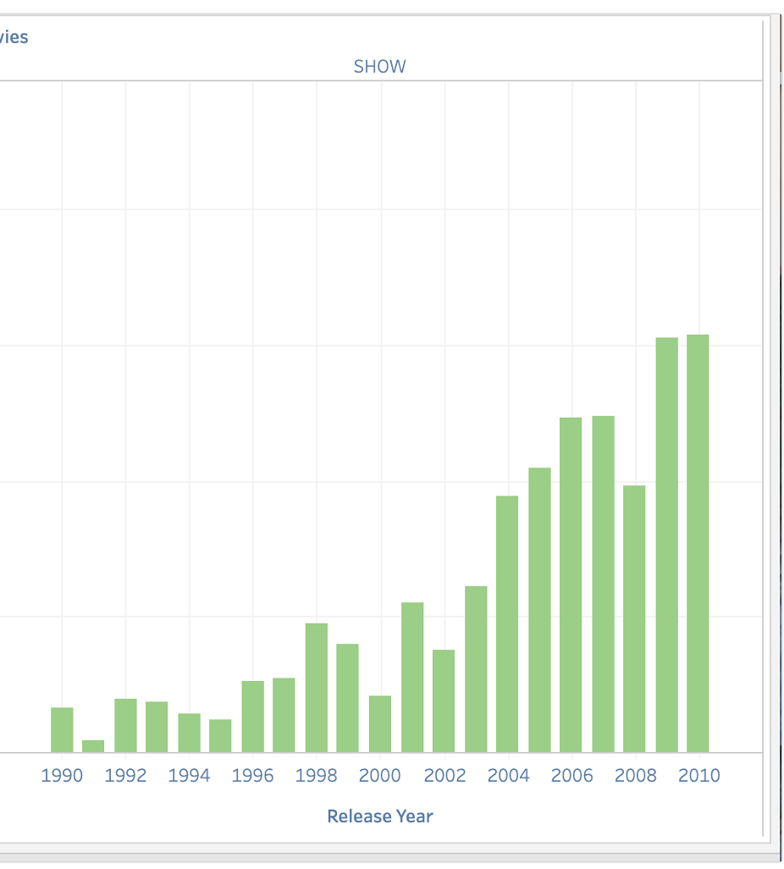
Runtimes Shows for Hulu were shorter in the 1990’s but remained constant for the last two decades.

Slide 46
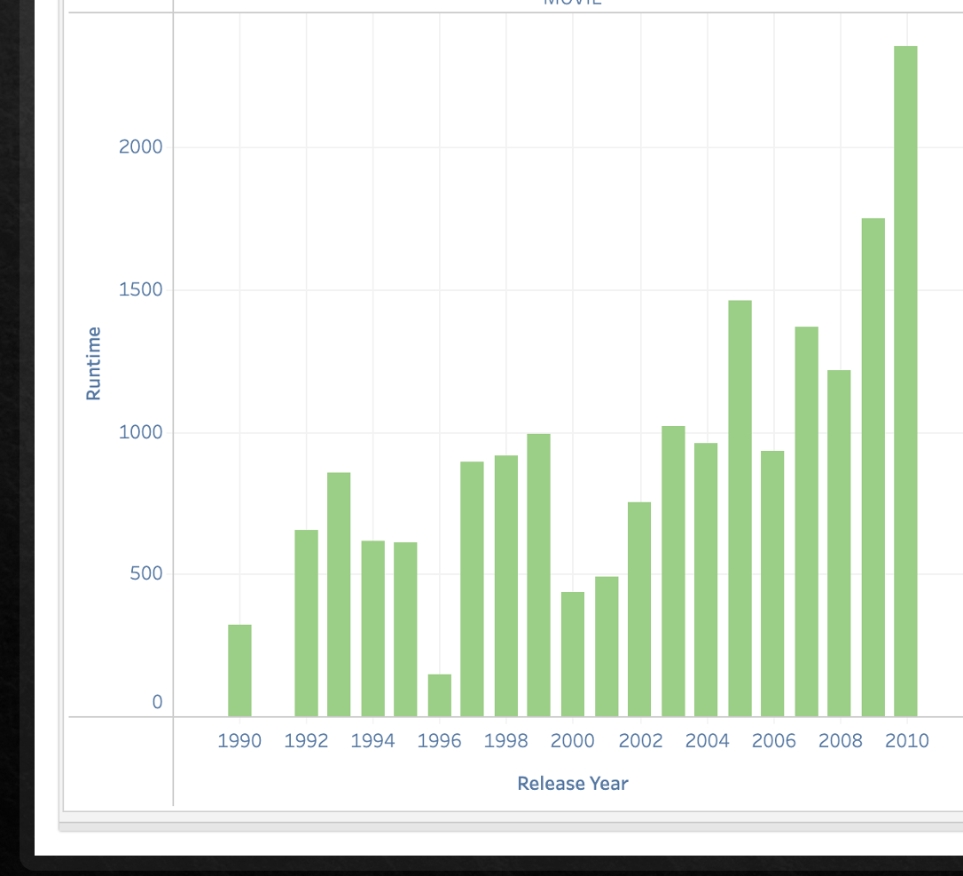
Runtimes Movies for Hulu were longer in the 1990’s and has remained constant

Slide 47
QUESTION 2: Have IMDB ratings changed for movies and shows over the decades? If, so how?
Running the same tests on IMDB scores as I did on runtimes over the decades showed that there is some statistically significant variance to be explored!

Slide 48
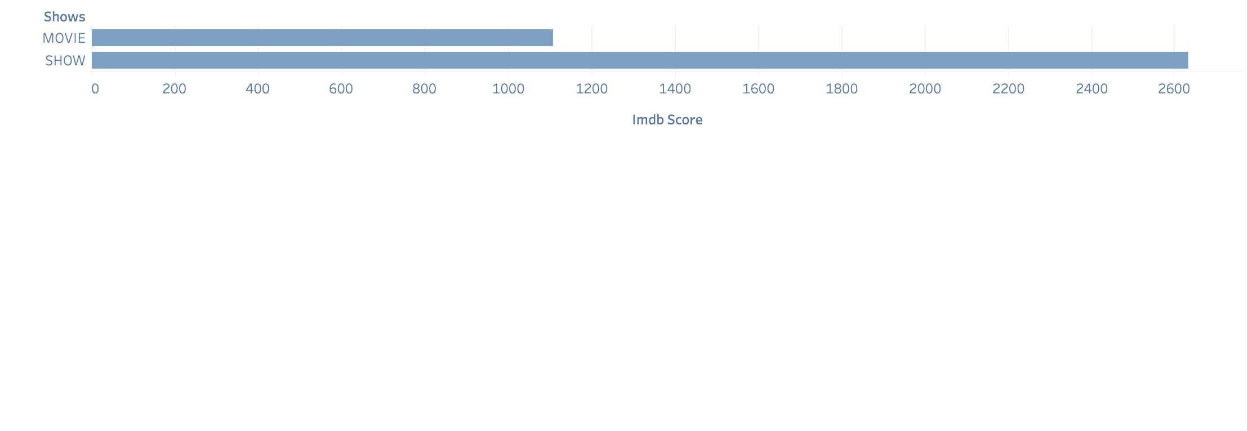
How have IMDB scores changed for shows and movies over the decades?

Slide 49
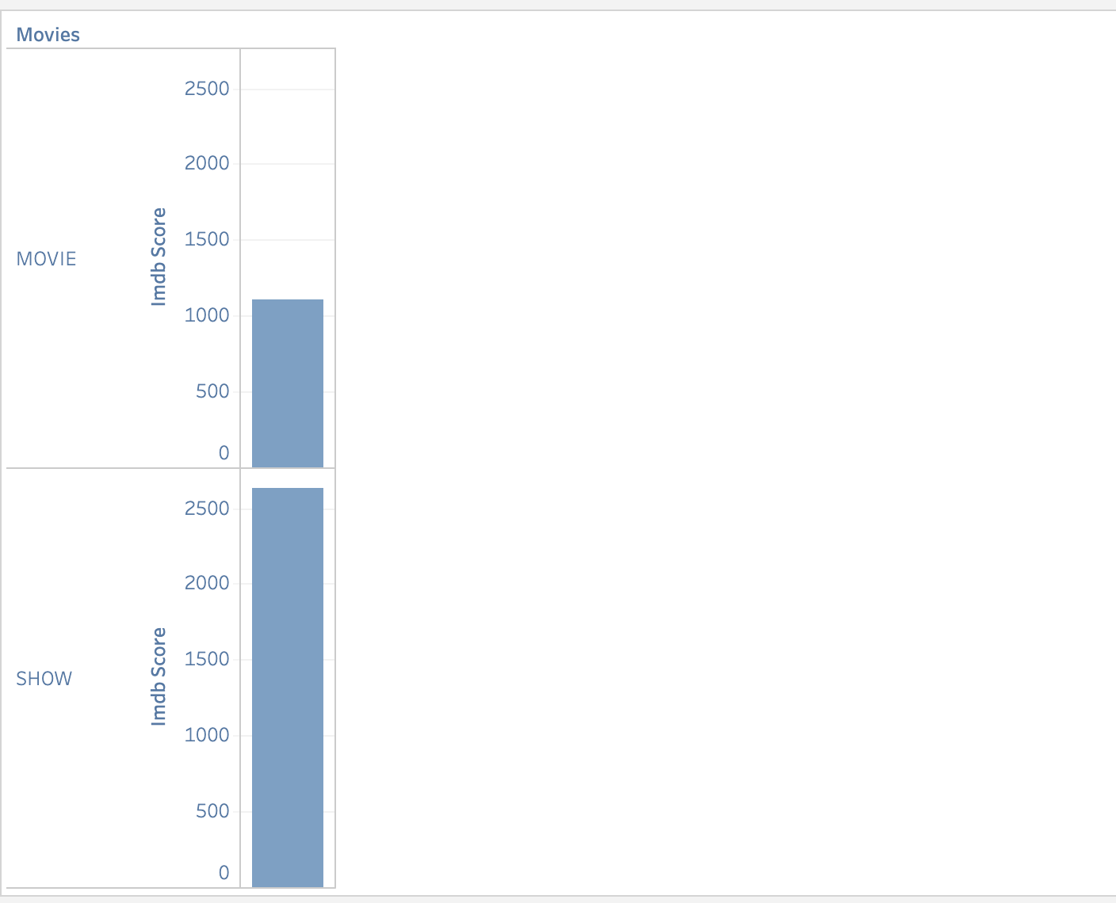
How have IMDB scores changed for shows and movies over the decades?

Slide 50
Now that we can see after running the IMDB Score, it shows that shows are more popular than movies.

Slide 51
I ran a T-test to see if the average IMDB scores for Hulu were the same as the average IMDB scores for the combined data set. First, I explore movies. The test showed that there IS a significant difference between the overall average IMDB score and the Hulu IMDB score for movies. Next the test for shows revealed that there was NOT a statistically significant difference between the Hulu average and the overall average.
Does Hulu Measure up against HBO and Netflix

Slide 52
Combining the Data Sets
After I had a great understanding of the Hulu data set, I wanted to see how it compared to some of the other major streaming services.
I merged the Hulu data set with a Netflix and HBO data set to make one big streaming services data set.
I took some time to research this new blended data set in R.
Once I discovered the mean IMDB scores for the combined data set for both movies and shows, it was time to compare!

Slide 53
IMDB Comparison
One Sample t-test
For Hulu Shows IMDB_SCORE
t = 4.6823, df = 1249, p-value = 3.147e-06
alternative hypothesis: true mean is not equal to 7
95 percent confidence interval:
7.085988 7.210012
sample estimates:
mean of x
7.148
One Sample t-test
For Hulu Movies IMDB_SCORE
t = -2.1131, df = 981, p-value = 0.03484
alternative hypothesis: true mean is not equal to 6.2
95 percent confidence interval:
6.06075 6.19485
sample estimates:
mean of x
6.1278

Slide 54
Reference page
https://backlinko.com,forHuluiewshipandsubscriberstatistics
https://trello.com/b/dyuczLm8/streaming-services-final-project

Slide 55
Insights into Streaming Services
Now that the team has presented a thorough understanding of Netflix, Hulu and HBO they will examine how IMDB scores, and runtimes relate across the different streaming services.

Slide 56
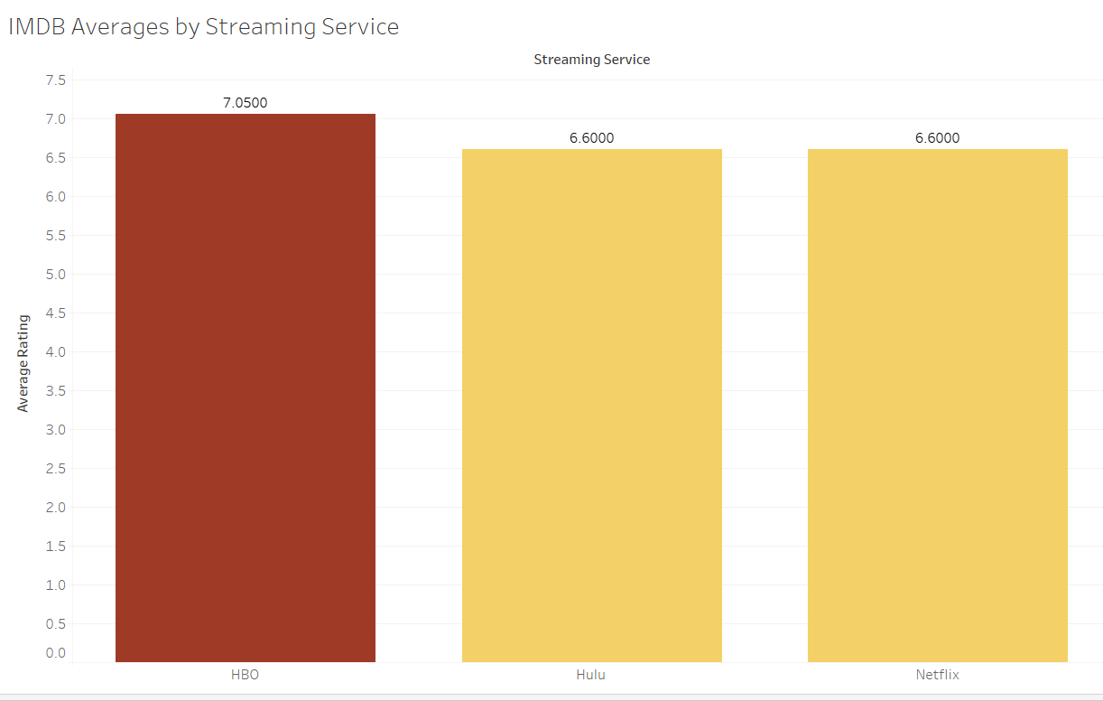
Which Streaming Service is the Most Popular?
7.1
6.6
6.6
HBO
HULU
NETFLIX

Slide 57
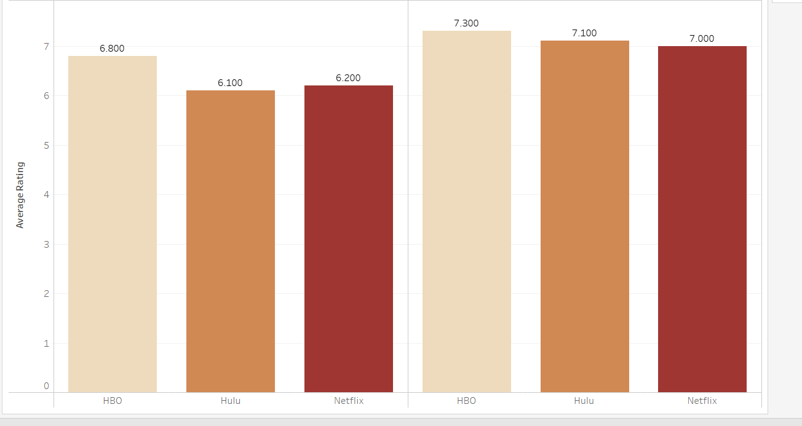
Average IMDB by Movie and Show
MOVIES
SHOWS
6.8
6.1
6.2
7.3
7.1
7.0
HBO HULU NETFLIX
HBO HULU NETFLIX

Slide 58
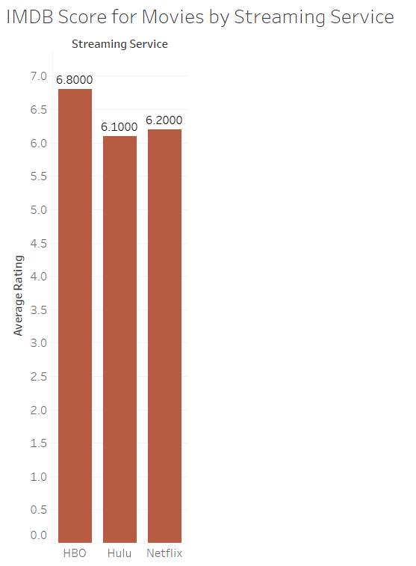
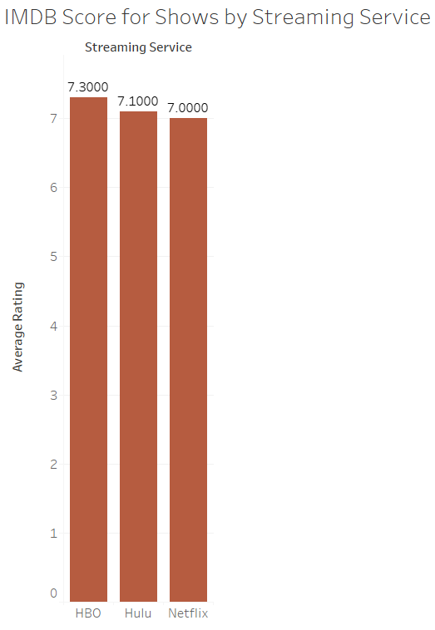
Breakdown by Movies and Shows
MOVIES
SHOWS

Slide 59
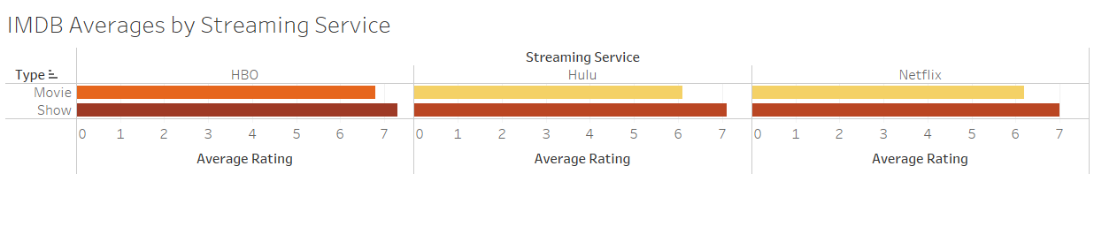
Further Comparisons

Slide 60
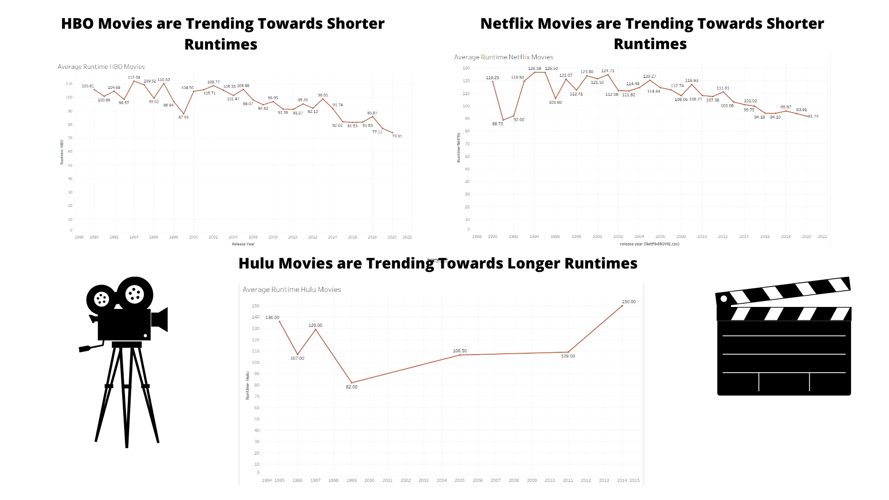
How Runtime Trends Compare

Slide 61
Summary of Observations
Overall streaming services shows scored significantly higher than movies.
HBO has higher scores across shows, movies and overall than both Hulu and Netflix.
When looking at runtimes over all media forms through the decades Netflix and HBO both trend towards longer runtimes while Hulu is trending towards shorter runtimes.

Slide 62
Netflix Conclusion
Netflix seems to be dipping in popularity overall, as seen by their IMDB scores being on par or less than HBO and Hulu, as well, as the unprecedented dip in their overall subscribers in 2022.
While still widely used and very popular Netflix will need to work to adapt to the increased competition form competing streaming services.
Focusing on shows for mature audiences, and focusing on movies over television would play into Netflix’s strengths
Reworking their programming for children and families as well as their movie selection could help to raise scores that are low.

Slide 63
Hulu Conclusion
Hulu is the leading online streaming service and comprehensive all I one premium service that offers an expansive slate of live and on demand. Over the past few years Hulu seen to be gaining more subscribers due to it’s live streaming of sports and other movie services it offers
There are sill several other companies that are joining the online streaming game, so it would be interesting to see how Hulu stand against them all.

Slide 64
Questions?

